Slide 1
Drilling Practices
Casing Operations
Handling, Running - Procedure
Landing Casing, Slips, Seals
Notes:
Forward-looking statements and estimates in these presentation materials are subject to risks and uncertainties which could cause actual results to differ materially. A discussion of significant risk factors can be found on page 40 of this booklet.

Slide 2
Casing Joints
A casing string is composed of a number of segment lengths referred to as “joints”.
A “joint” of casing is identified by four parameters:
  Outside diameter (OD)
  Normal weight per foot
  Grade of steel
  Thread type of connection at either ends of the “joint”.

Slide 3
Pipe Marking
Pipe should be marked by die stamp or with paint as follows:
  Manufacture’s / Processor’s name or mark
  API Spec 5CT: Size, Weight per foot, Grade
  Process of manufacture, length, test pressure, type of thread, heat treatment.

Slide 4
Pipe Marking
Each joint should be color coded with a paint band encircling the pipe on or near the coupling or box.
Pipe and couplings may have an external coating for protection from rust while in transit.

Slide 5
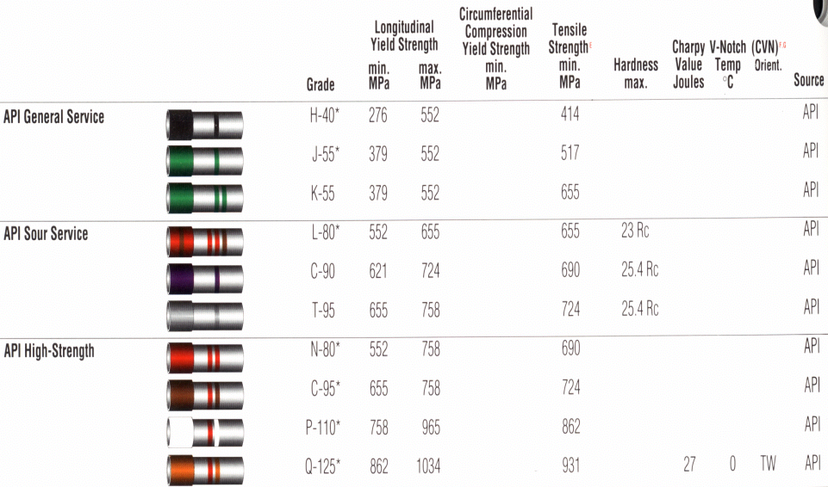
Pipe Grade Color Coding

Slide 6
Receiving Pipe Tally

Slide 7
Receiving Pipe Tally

Slide 8
Casing Running and Landing
Preparation to run casing:
  Prior to running, perform landing calculations per weight and grades
  Clearly label all joints to be left OUT
  Review planned landing details with:
    Rig Personnel - Toolpusher, Driller
    Casing Crew - Supervisor

Slide 9
Casing Running and Landing
Running casing:
  Consider - Re-tally and re-number as run in hole (Running Order)
  Run pipe at a moderate rate to minimize surge pressures created while lowering casing into wellbore ~1,000 fph or less per well conditions.

Slide 10
Running Pipe Tally

Slide 11
Running Pipe Tally

Slide 12
Running Pipe Tally - Landing

Slide 13
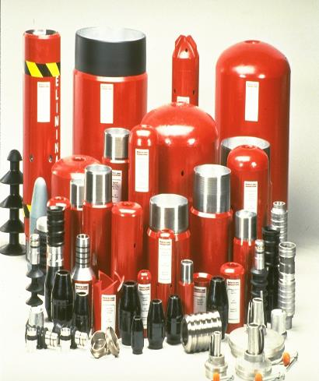
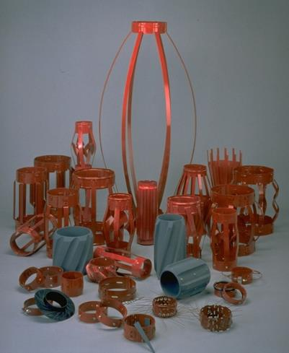
Casing Accessories

Slide 14
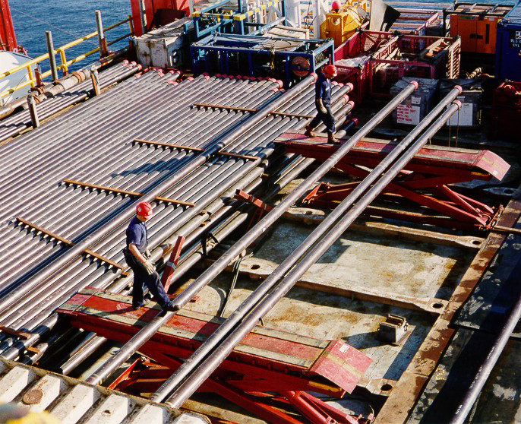
Pipe Deck - Offshore

Slide 15
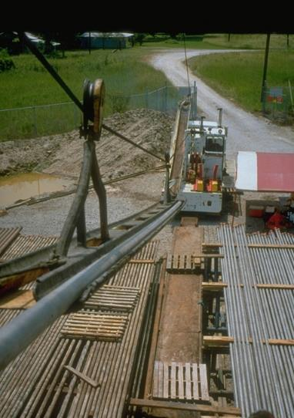
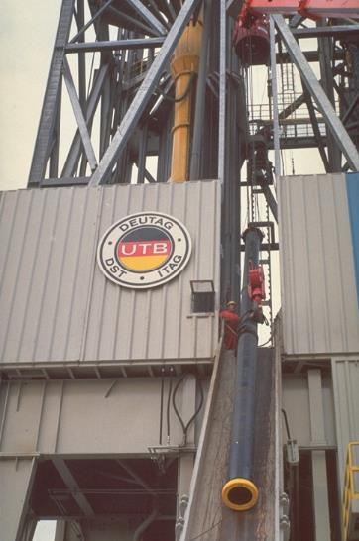
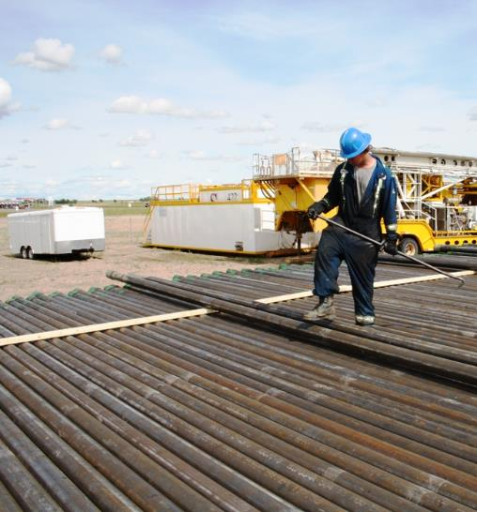
Running Casing
Onshore / Offshore

Slide 16
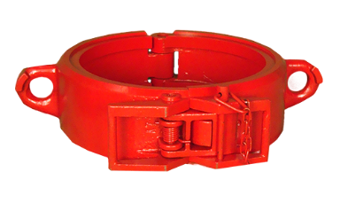
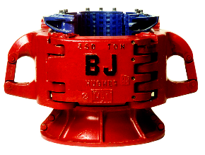
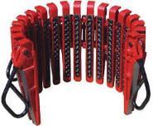
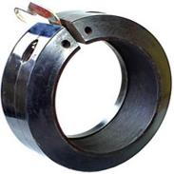
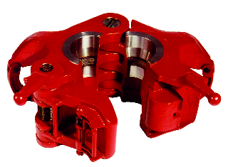
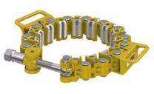
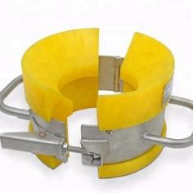
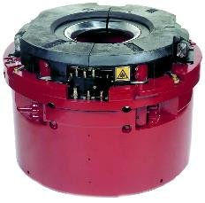
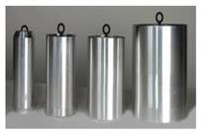
Casing Handling Equipment
Single Joint Elevator
Casing Slip
Clamp On
Spider Elevator
Safety Clamp
Side Door Elevator
Spider Slip
Stabbing Guide
Casing Drift

Slide 17
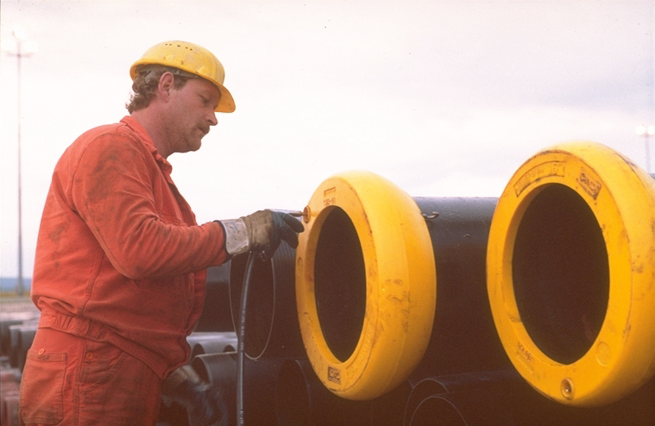
Casing Accessories - Protectors

Slide 18
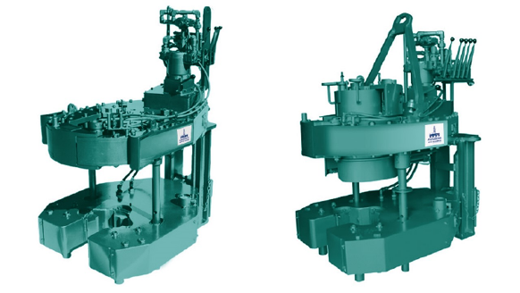
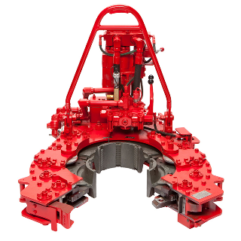
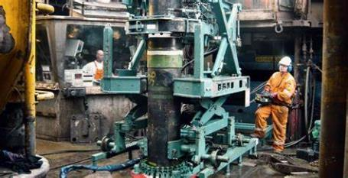
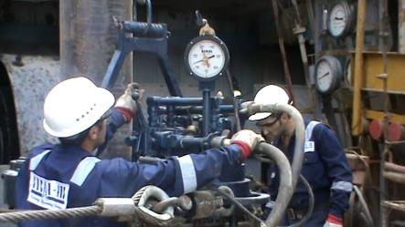
Casing Power Tong

Slide 19
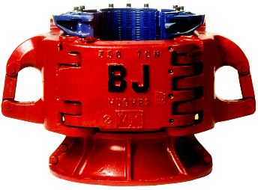
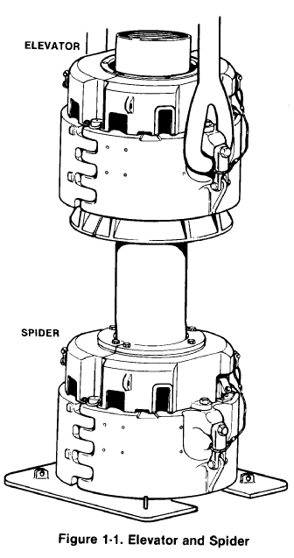
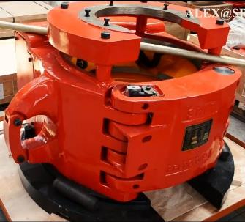
Elevator / Spider
Spider Elevator
Spider Slip

Slide 20
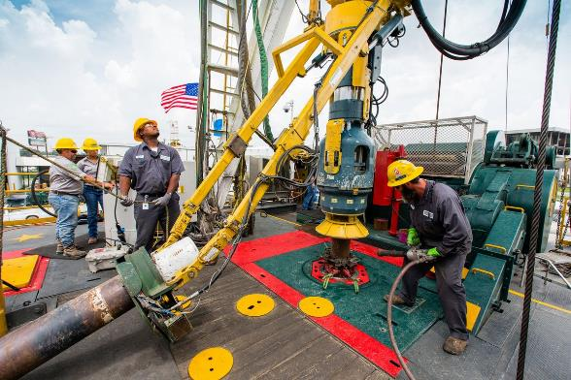

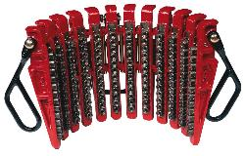
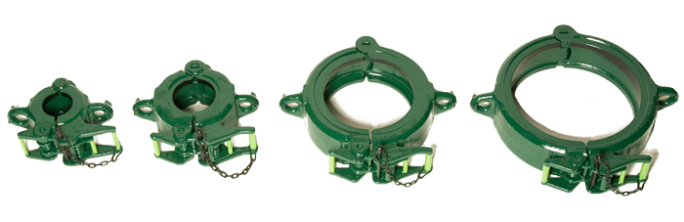
Spider Elevator
Casing Elevator
Single Elevator

Slide 21
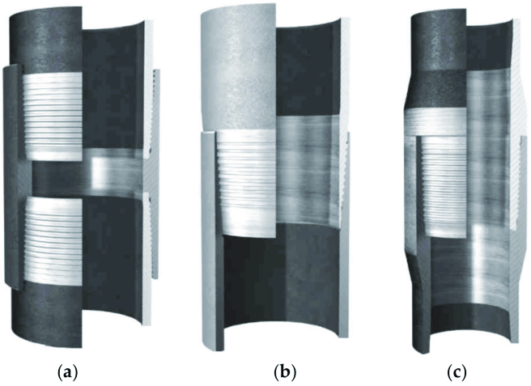

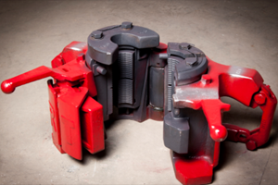
Casing Connection Type → Casing Handling
a → use Side Door Elevator
Threaded and coupled;
Integral flush;
Integral upset connection
b and c → use Slip Type Elevator

Slide 22
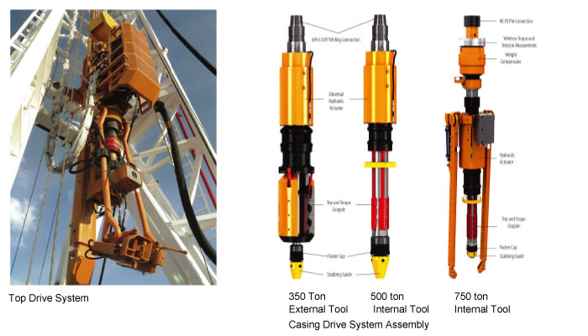
Casing Handling Equipment – CDS (Casing Drive System)

Slide 23
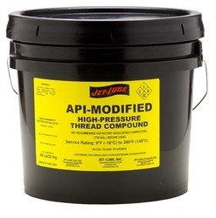
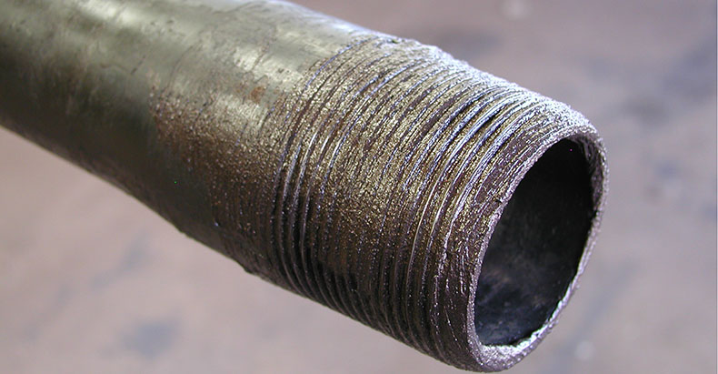
Casing Dope

Slide 24
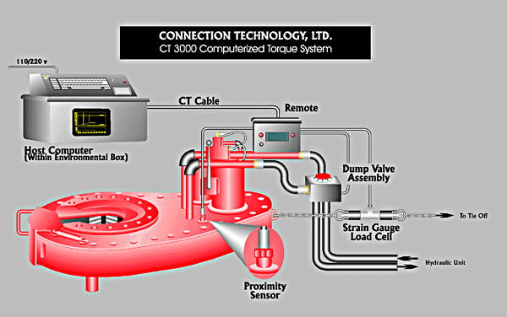
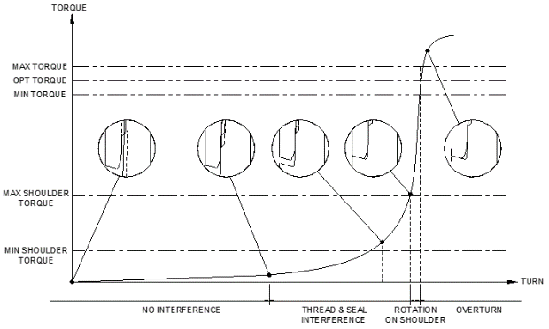
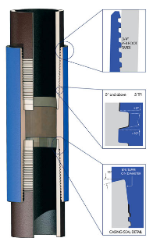

Casing MU Torque Monitoring
Torque Chart
Torque Turn Equipment
Premium Thread

Slide 25
Drilling Sequence
Drive Pipe
Cut off excess Drive Pipe per program
Install temporary wellhead
Nipple up Diverter
Drill Conductor hole

Slide 26
Drilling Sequence
Structural (Conductor)
Run Conductor Pipe
Run conventional float equip (thread lock btm 2 jts)
Pump Cement to Surface - be prepared to washout excess cement
Center Conductor prior to cement set

Slide 27
Drilling Sequence
Structural (Conductor)
Wait on Cement
Cut Temporary Head off Drive pipe
Cut Conductor pipe in preparation for wellhead equipment

Slide 28
Drilling Sequence
Structural (Conductor)
Install “A” section of wellhead
Weld “A” section on Conductor
Nipple up Diverter
Drill Surface Hole

Slide 29
Drilling Sequence
Surface
Run Surface Pipe
Run conventional float equip (thread lock btm 2 jts)
Pump Cement to Surface - be prepared to washout excess cement

Slide 30
Drilling Sequence
Surface
Install Slips:
  If hand set, wait on cement before remove Diverter (pump time + [1-2] hrs, discuss with Supervisor)
  If drop slips, then make sure no collars are in the way, may have to remove riser above Diverter

Slide 31
Drilling Sequence
Surface
Remove Diverter if not done so already
Install “B” section packoff in preparation for next Wellhead section

Slide 32
Drilling Sequence
Surface
Ready for next Wellhead section

Slide 33
Drilling Sequence
Surface
Install “B” section
Test void section between “A” and “B” sections:
  Do not exceed 80% of burst for Conductor
  Do not exceed 80% of collapse for Surface
Install BOP’s
Drill Next Hole

Slide 34
Drilling Sequence
Next Hole (Int or Prod)
Install Casing Rams in BOP’s
Run Next Pipe
Run conventional float equip (thread lock btm 2 jts)
Pump Cement per program

Slide 35
Drilling Sequence
Next Hole (Int or Prod)
Install Slips:
  If hand set, wait on cement before remove BOP (pump time + [1-2] hrs, discuss with Supervisor)
  If drop slips, then make sure no collars are in the way, may have to remove riser above BOP’s

Slide 36
Drilling Sequence
Next Hole (Int or Prod)
Remove BOP’s if not done so already
Install “C” section packoff in preparation for next Wellhead section

Slide 37
Drilling Sequence
Next Hole (Int or Prod)
Ready for next Wellhead section

Slide 38
Drilling Sequence
Next Hole (Int or Prod)
Install “C” section
Test void section between “B” and “C” sections:
  Do not exceed 80% of burst for Surface Pipe
  Do not exceed 80% of collapse for Next Pipe, check loads
If more hole, install BOP’s
If not, install Tree

Slide 39
Liner
Run Liner to depth, set Hanger
  Perform cement job
  Don’t over-displace, Liner wipers have tendency to be inefficient
Pump cement above hanger (discuss with Supervisor), unless planning on running a Liner top squeeze
Drill Pipe to run and cement Liner
Liner Hanger
Liner

Slide 40
Liner
After pumping cement
  Immediately, pull 5-10 stands of DP to circulate clean
  Be prepared for the U-Tubing
  Upfront planning is required & critical
Tieback:
  If not using,then install Tree.
  If using, then another Wellhead section is required.
Drill Pipe TOH
Liner Hanger
Liner

Slide 41
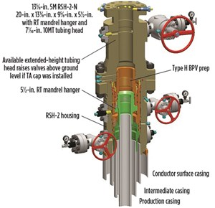
Ready for Completion

